Slide 1
Data-thon VAIDYUTAK 3.0 submissions
Team data Titans

Slide 2
TEAM Members
TIRTHAJIT BORAL
ATIF AKHTAR
MD. TARIQUE HUSSAIN
SUDHANSHU MISHRA

Slide 3
Online Retail Transaction analysis
PROBLEM-1

Slide 4
Content
Introduction
Libraries
Data description
Exploratory Data Analysis(EDA)

Slide 5
Introduction to datasets
this dataset collects vital information for organisations looking to improve their client base understanding by including a variety of factors connected to customer purchase habits. Age, gender, purchase amount, preferred payment methods, frequency of transactions, and feedback ratings are among the aspects that customers can choose from.
Data is also provided on the kinds of goods bought, how often they buy, when they like to shop, and how they use special offers.
This 4720-record dataset provides a starting point for companies wishing to use data-driven insights to improve decision-making and customer-focused strategy.

Slide 6
Python Libraries used
Pandas
Numpy
Matplotlib
Seaborn

Slide 7
Data set 1

Slide 8
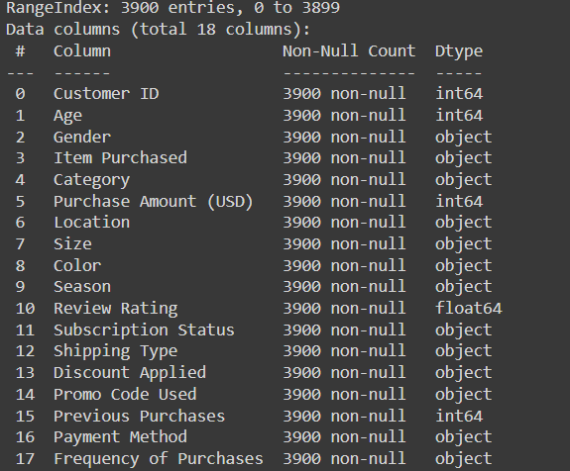
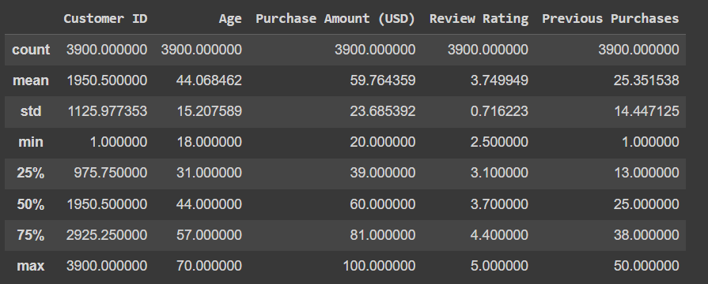
Data information
Data Info :
Data Describe:

Slide 9
Data Information
No Duplicate Value present in the data set
No missing values present in the data set
Dimension of Data set indicates that we have 3900 rows and 17 columns also known as features of our data.

Slide 10


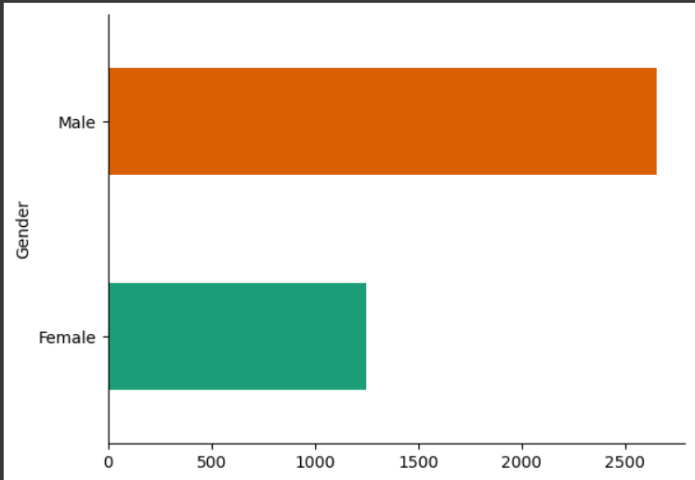
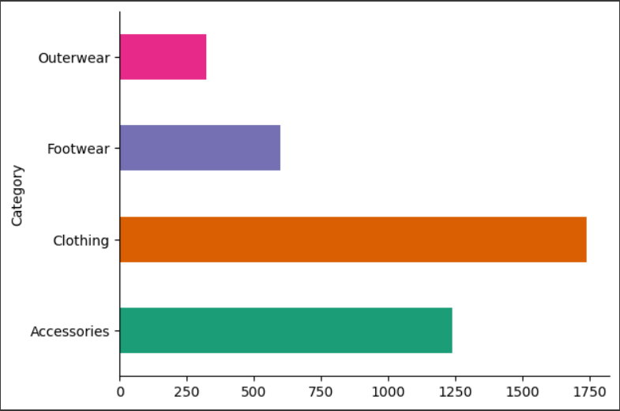
Exploratory data analysis
Category distribution within the data suggest that clothing has the highest count.
Gender Distribution-Most of the customers are male.

Slide 11
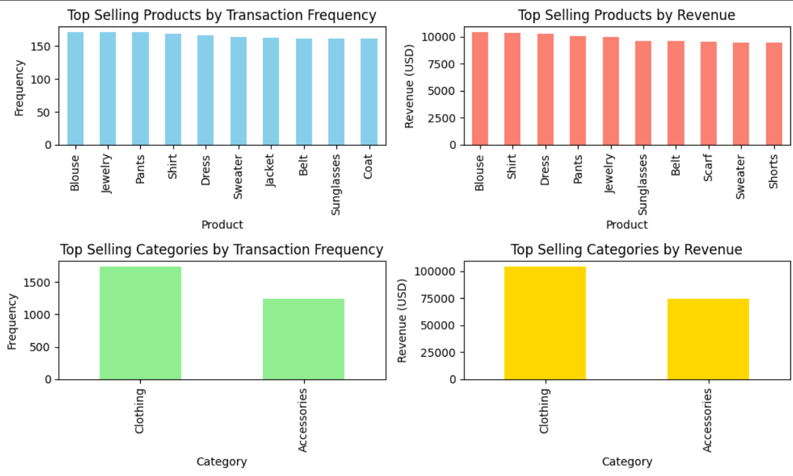
Top-Selling Products and Categories
THE GIVEN FIGURES SUGGEST THE TOP SELLING PRODUCTS AS PER TRANSACTION FREQUENCY AND REVENUE.
THUS,THE PLOT PROVES THAT CLOTHING AND ACCESSORIES ARE THE TOPMOST 2 SELLING PRODUCTS BY REVENUE AND FREQUENCY.

Slide 12
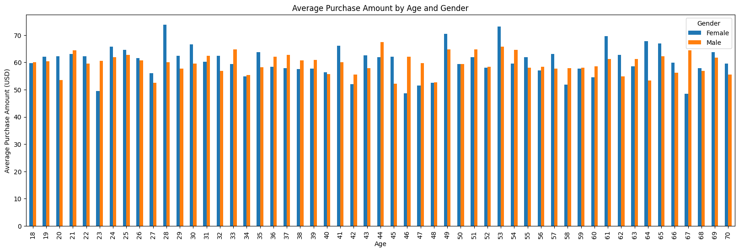
Analyzing purchasing behavior

Slide 13
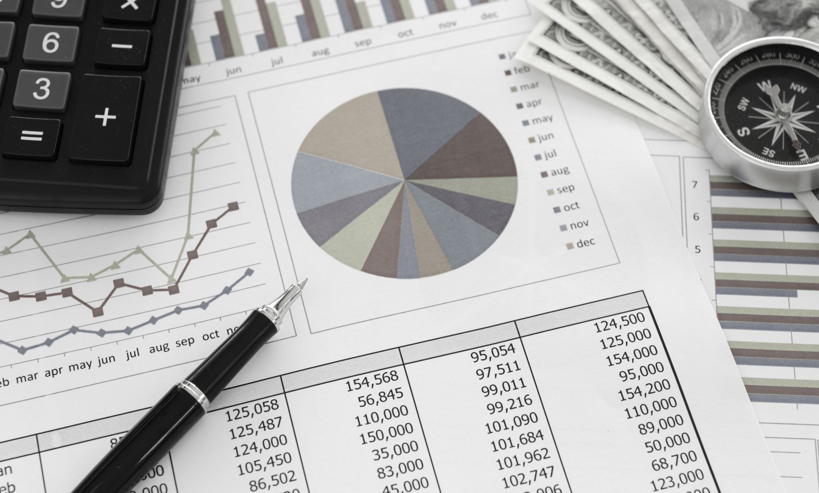
Analyzing purchasing behavior
THE PREVIOUS FIGURE SHOWCASED THE PURCHASE TRENDS GROUPED BY AGE AND GENDER.
WE SEE THAT THE MOST PURCHASES WERE MADE BY CUSTOMERS WITHIN THE AGE LIMIT OF 25-55 THUS SHOWING OUR TARGET AUDIENCE.
PayPal 17.358974 Credit Card 17.205128 WE SEE THAT ALL PAYMENT METHODS ARE PREFERABLE EQUALLY. Cash 17.179487 Debit Card 16.307692 Venmo 16.256410 Bank Transfer 15.692308

Slide 14
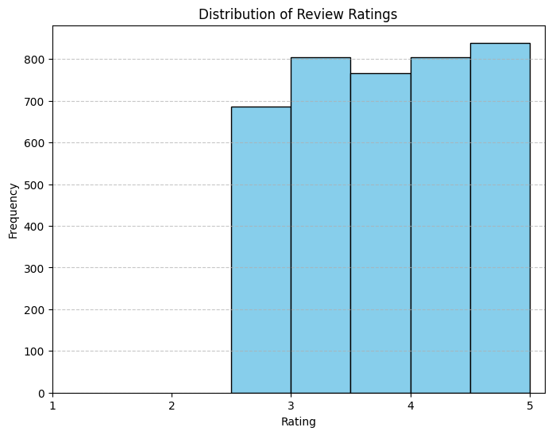
Customer Ratings and Product Satisfaction
ThIS PLOT SUGGESTS THAT MOST OF THE PRODUCTS ARE RATED OVER 3.
IT ALSO HIGHLIGHTS THAT SOME PRODUCTS NEED IMPROVEMNT.

Slide 15
IMPROVEMENT AREAS
THE FOLLOWING PRODUCTS RATED BELOW 3.75 NEED IMPROVEMENT IN THEIR QUALITY FOR MORE PURCHASES AND AUDIENCE ENGAGEMENT.
Blouse 3.683626
Coat 3.730435
Hoodie 3.719205
Jeans 3.648387
Pants 3.718713
Scarf 3.700000
Shirt 3.629586
Shoes 3.747333
Shorts 3.711465
Sunglasses 3.744720

Slide 16
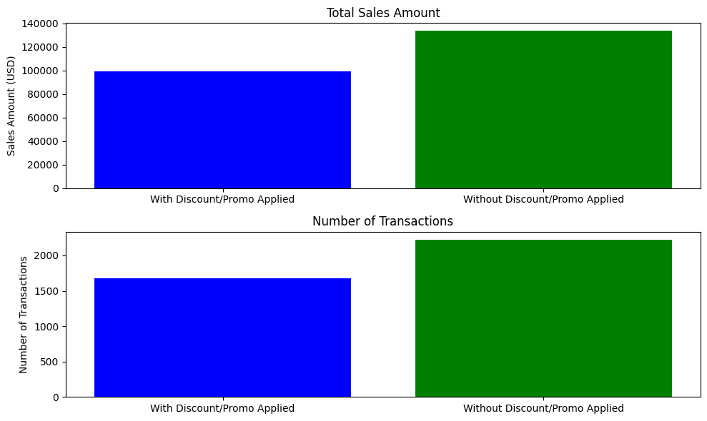
Impact of Discounts or Promotions
Number of customers who have purchased with discount applied and promo code used: 1677
Percentage of customers who have purchased with discount applied and promo code used: 43.0 %
THUS IMPROVEMENT IN DISCOUNTS OR PROMO CODES PERCENTAGES ARE SUGGESTED.

Slide 17
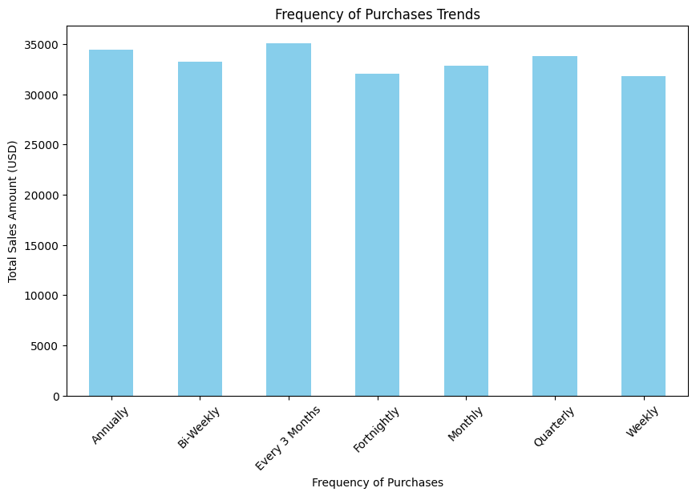
Seasonality of Product Purchases
THE PLOT SUGGESTS THAT MOST PURCHASES WERE DONE ANNUALLY OR EVERY 3 MONTHS.
THIS IS AN INDICATOR OF REPEAT PURCHASES.

Slide 18
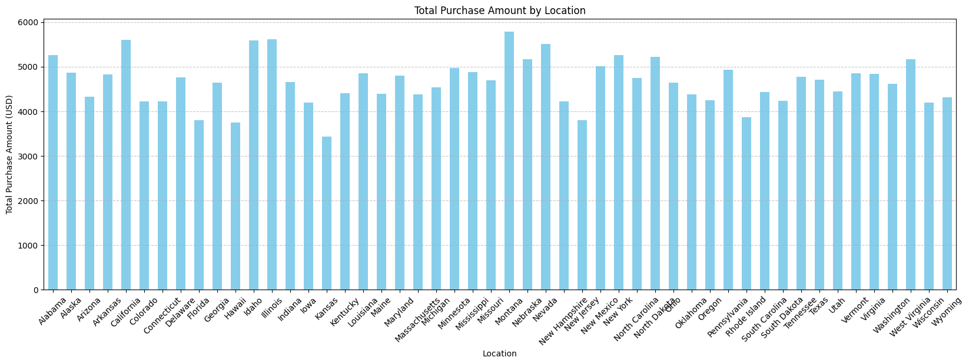
VARIATION OF PURCHASE AMOUNT W.R.T LOCATION

Slide 19
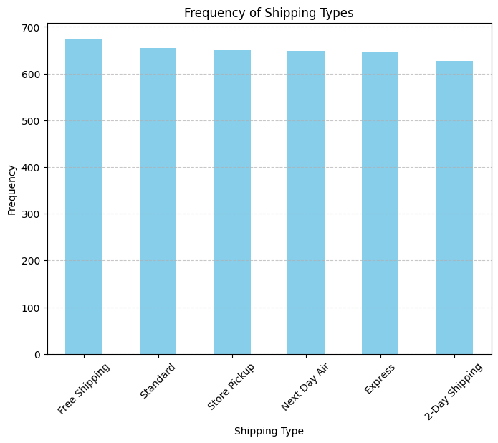
SHIPPING TYPES ANALYSIS
THE MOST PREFFERED SHIPPING TYPE AMONG CUSTOMERS WAS FREE SHIPPING OPTION.

Slide 20
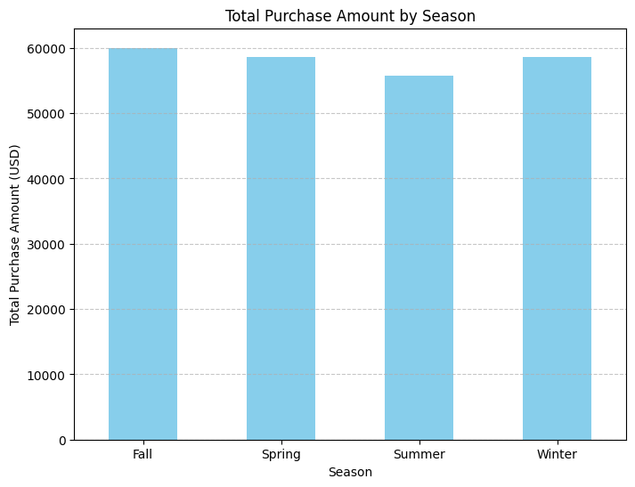
SEASON WISE STATISTICS
THE PLOT REVEALS THAT FALL AND WINTER ARE THE PEAK SEASONS FOR THE BUSINESS IN TERMS OF PURCHASE AMOUNT.

Slide 21
Data set 2

Slide 22
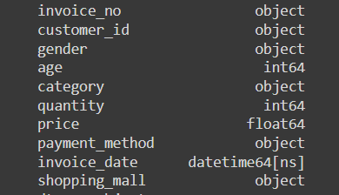
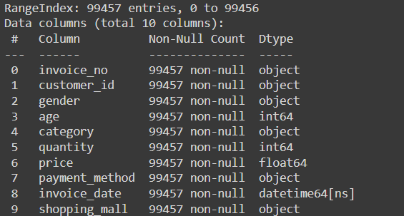
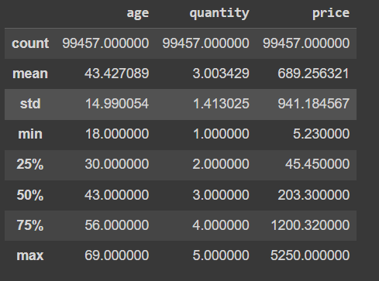
Data information
Features and their data types :
Data Info :
Data Describe:

Slide 23
Data Information
No Duplicate Value present in the data set
No missing values present in the data set
Dimension of Data set indicates that we have 99457 rows and 10 columns also known as features of our data

Slide 24
Data Cleaning and Preprocessing
Using the invoice data we are extracting date information in terms of month and year, and adding two new column called month and year
Using the data like quantity and price we have created a new column expressing the total amount

Slide 25
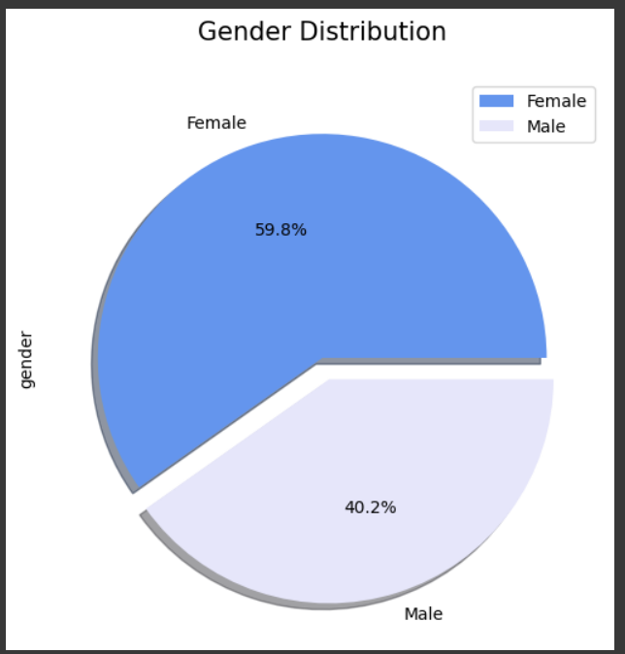
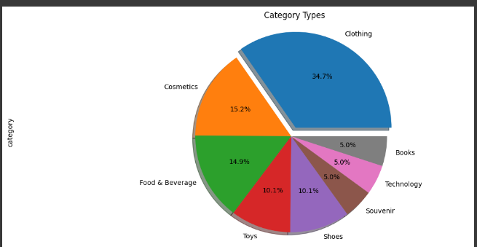
Exploratory data analysis
Distribution based on gender: Male 40.2% and Female 59.8%
We have 8 different or unique categories of product
Distribution of Transaction across different categories

Slide 26
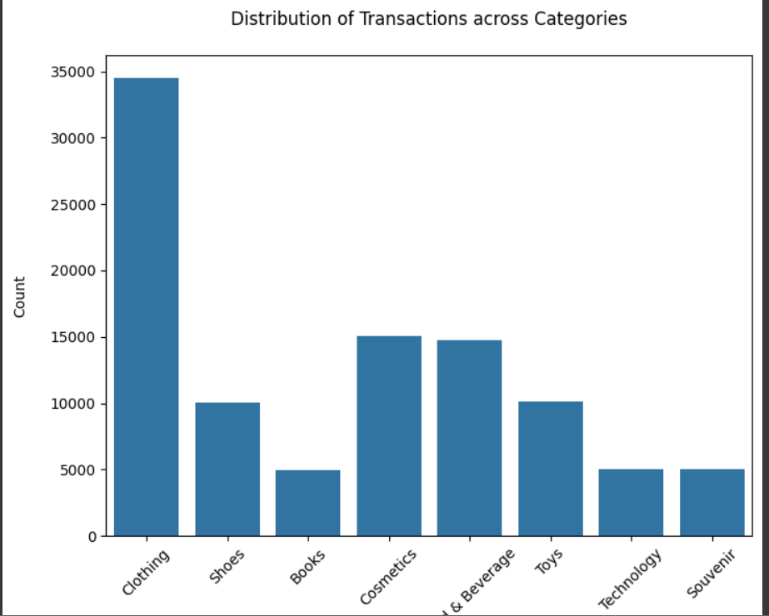
Exploratory data analysis
From the distribution across category we get that clothing was having the highest count and books was lowest

Slide 27
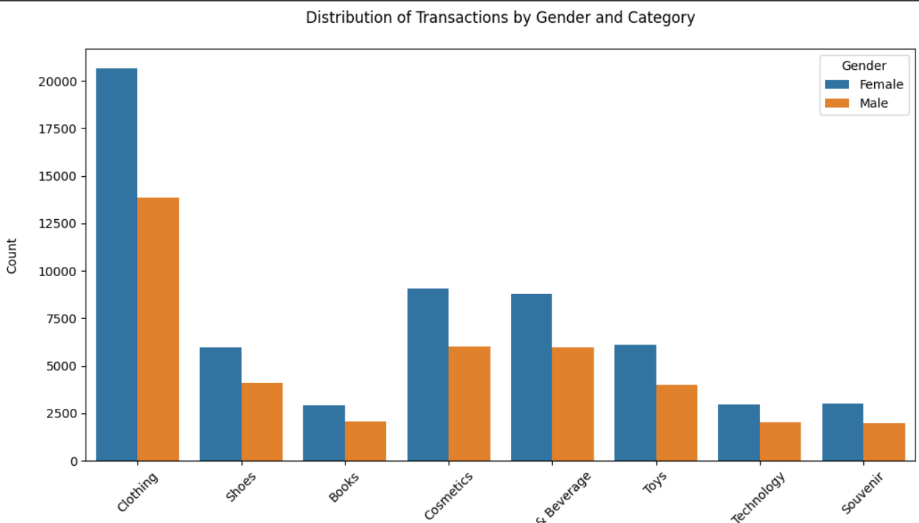
Exploratory data analysis
Distribution of the category between the male and female to understand the trend of item within gender

Slide 28
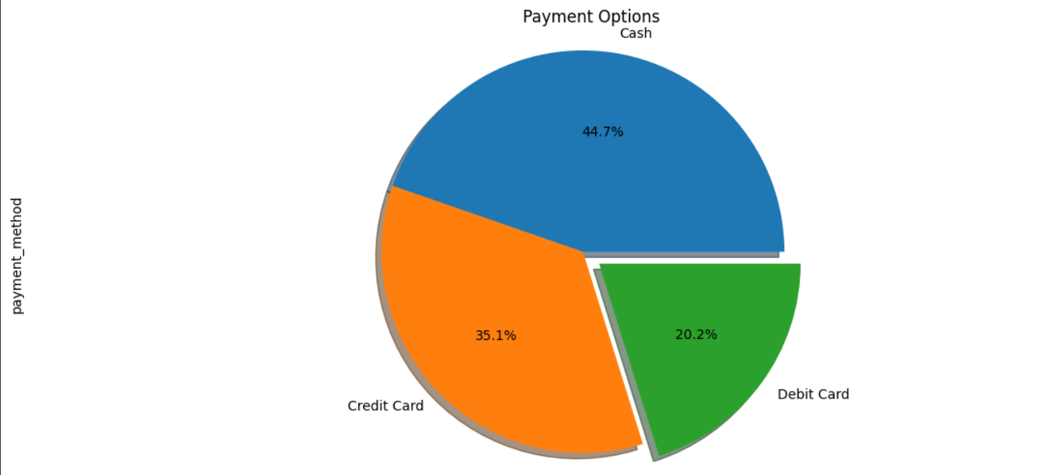
Exploratory data analysis
Distribution of the different mode of payment
The no of transaction was highest in cash with 44447 and least in debit card with 20079 and the third mode of payment that is credit card was 34931
The average of amount paid in form of cash was 2538 which is almost similar to other mode of transaction
Though the customer used cash for maximum time the large amount was still favoured to be paid using credit or debit card
Whereas cash was mostly used for lesser or small amount of transaction

Slide 29
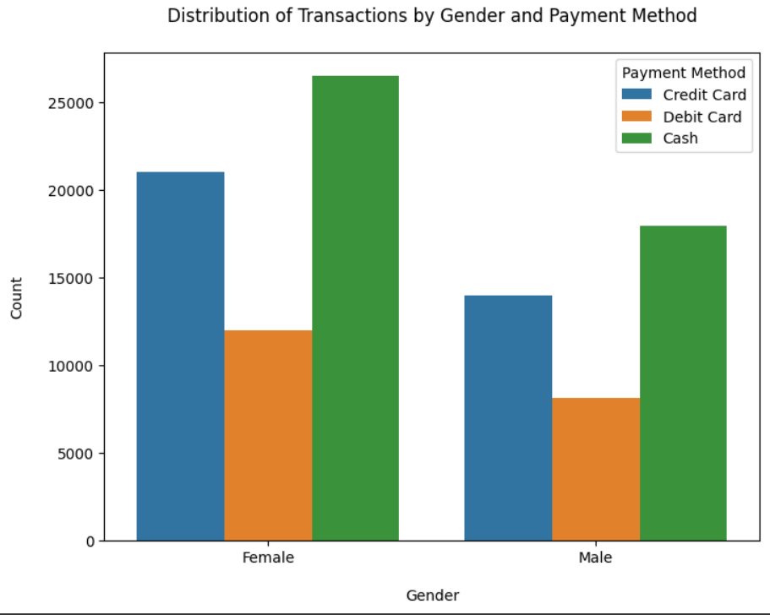
Exploratory data analysis
Females were the one who used cash as frequent mode of transaction

Slide 30
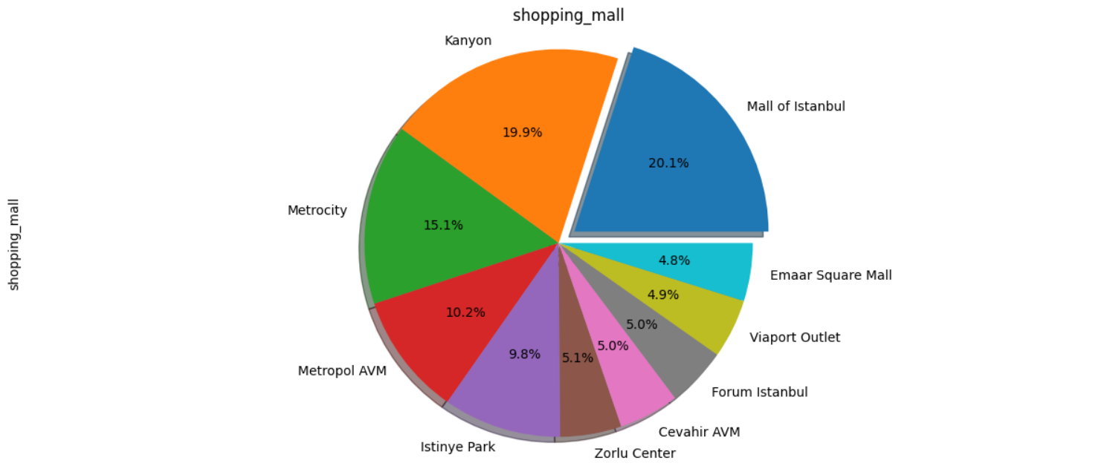
Exploratory data analysis
Distribution of transaction in each shopping mall

Slide 31
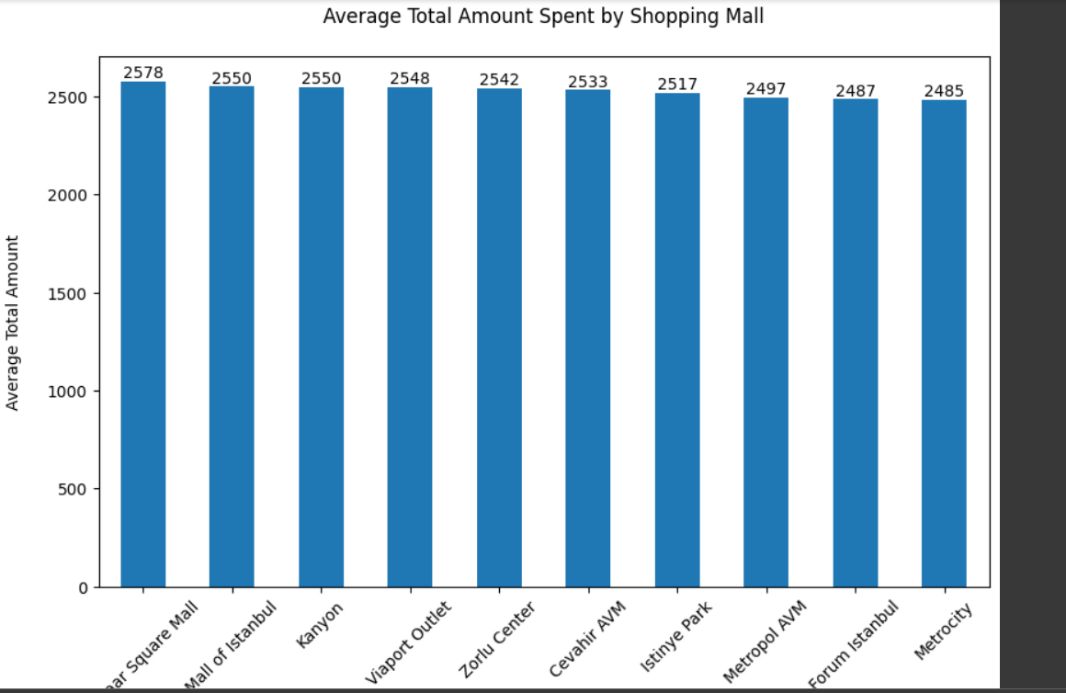
Exploratory data analysis
Average total amount spent by shopping mall

Slide 32
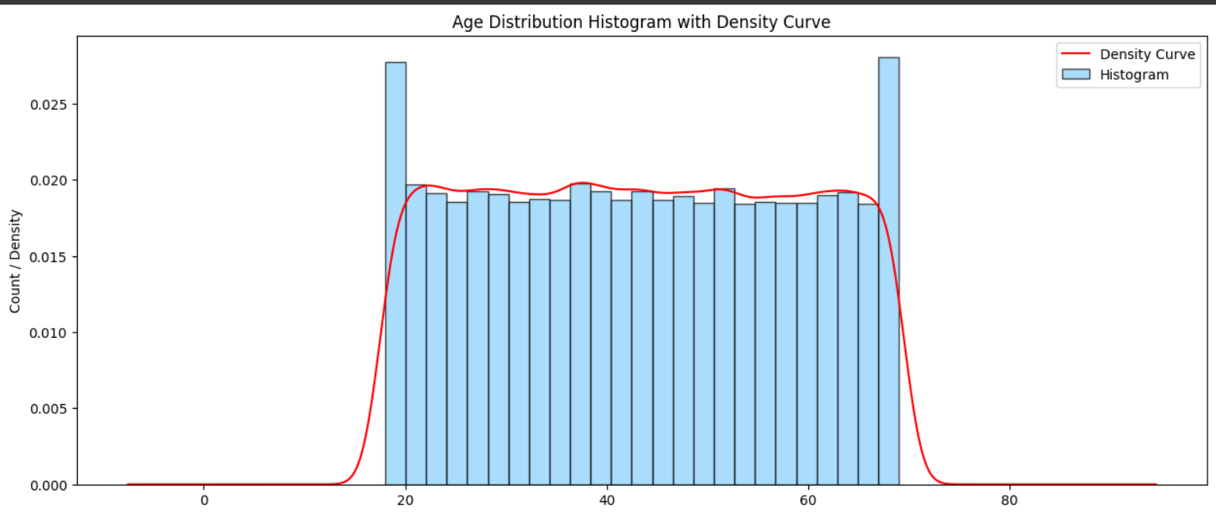
Exploratory data analysis
Age distribution

Slide 33
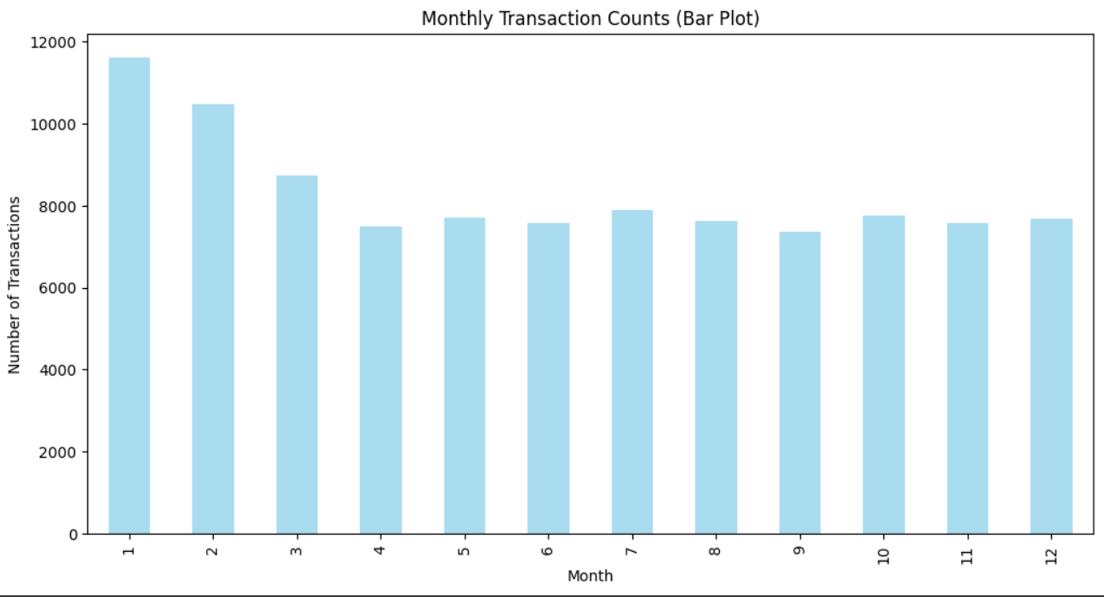
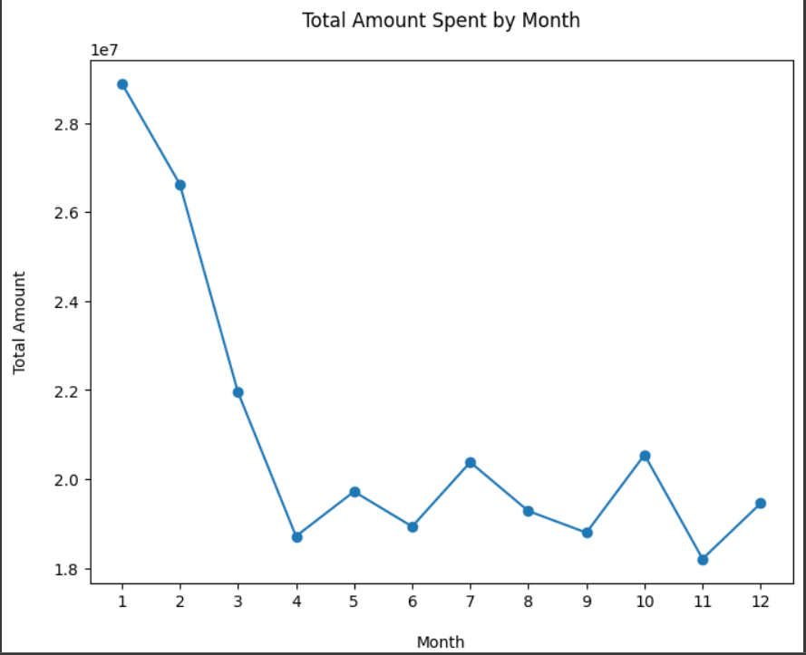
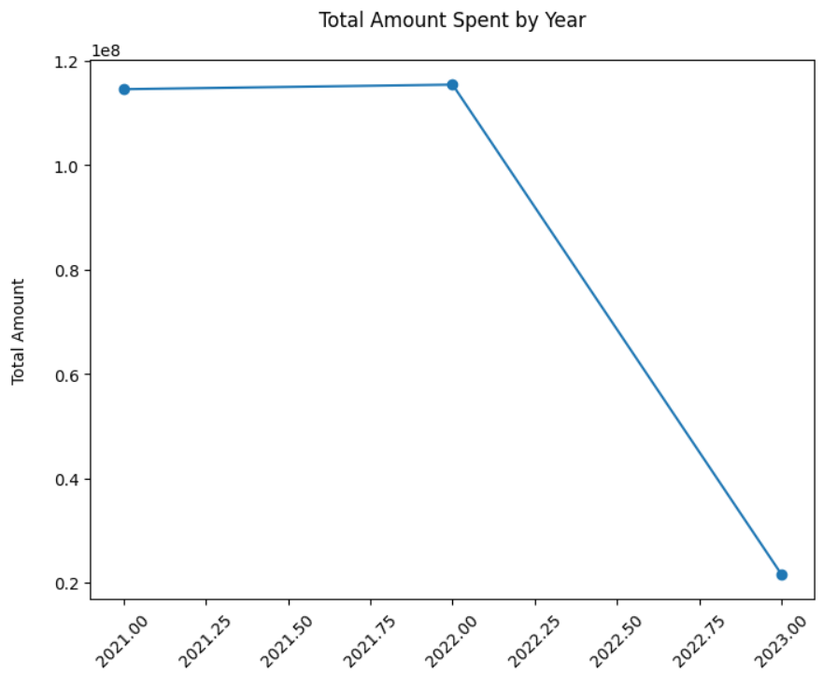
Exploratory data analysis
Monthly transaction counts tells us that January was the month where the sale was highest .
Total amount spent variations across various months and year :

Slide 34
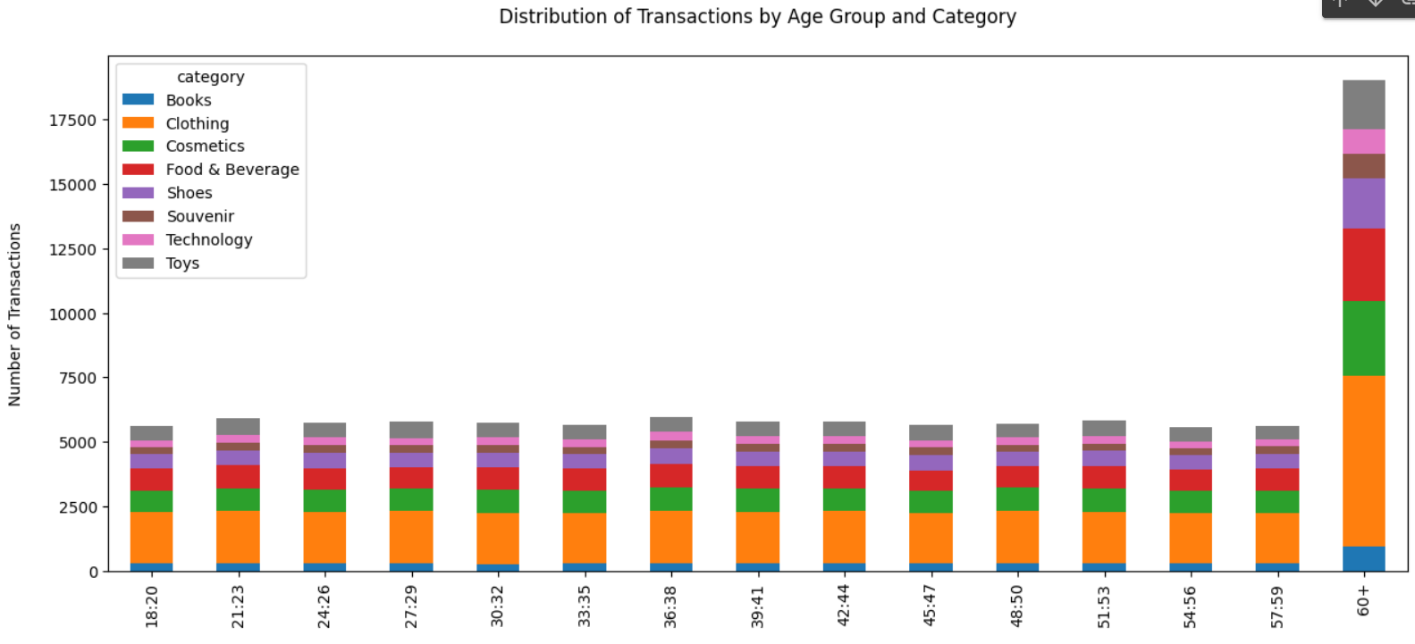
Exploratory data analysis
Monthly transaction counts tells us that January was the month where the sale was highest .
Total amount spent variations across various months and year :

Slide 35
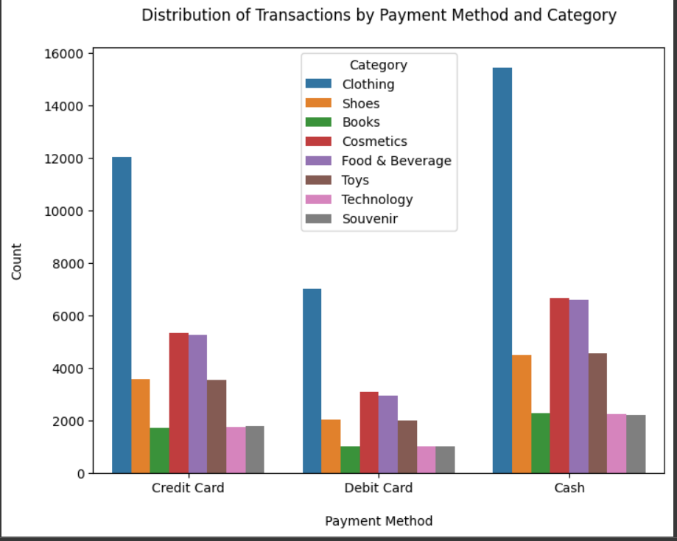
Exploratory data analysis

Slide 36
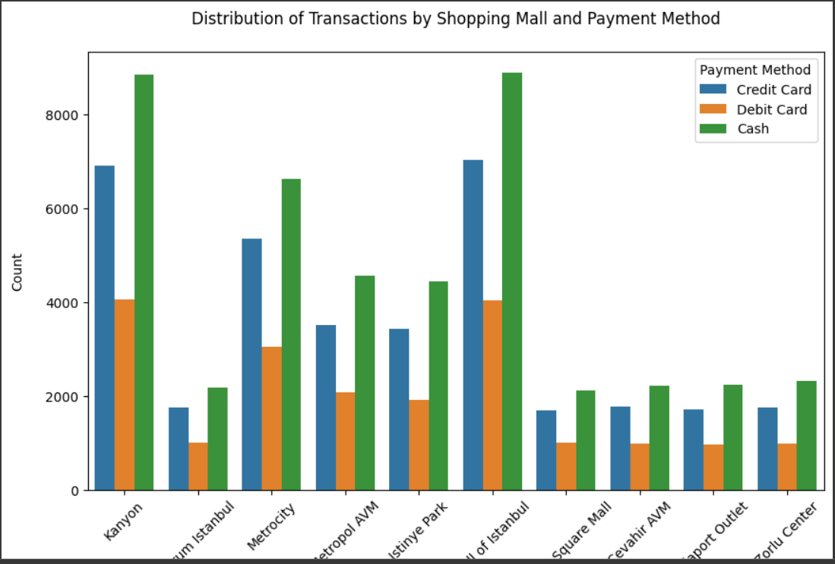
Exploratory data analysis

Slide 37
Conclusion
IN BOTH THE DATASETS, CLOTHING WAS THE MOST PREFERRED BUY AMONG THE CUSTOMER SEGMENT.
IN 1ST DATASET, ALL THE PAYMENT METHODS WERE EQUALLY PREFFERED BUT IN THE 2ND DATASET CUSTOMER MOSTLY PREFERRED TO PAY USING CASH.
Fall and winter were the peak season for dataset 1. however late winter from january was the peak season for dataset 2.

Slide 38
EXTRACTING LEGAL INSIGHTS FROM FIR IMAGES BY NLP
PROBLEM-2

Slide 39
Content
Introduction to Dataset
Libraries
Image Preprocessing
Text Extraction process
Text Extraction Result
Conclusion

Slide 40
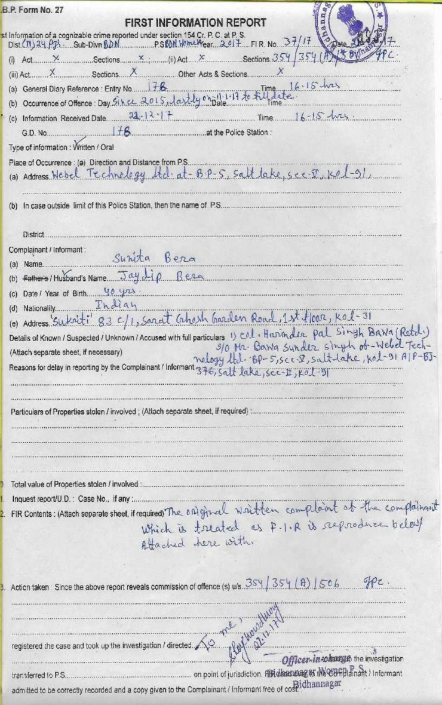
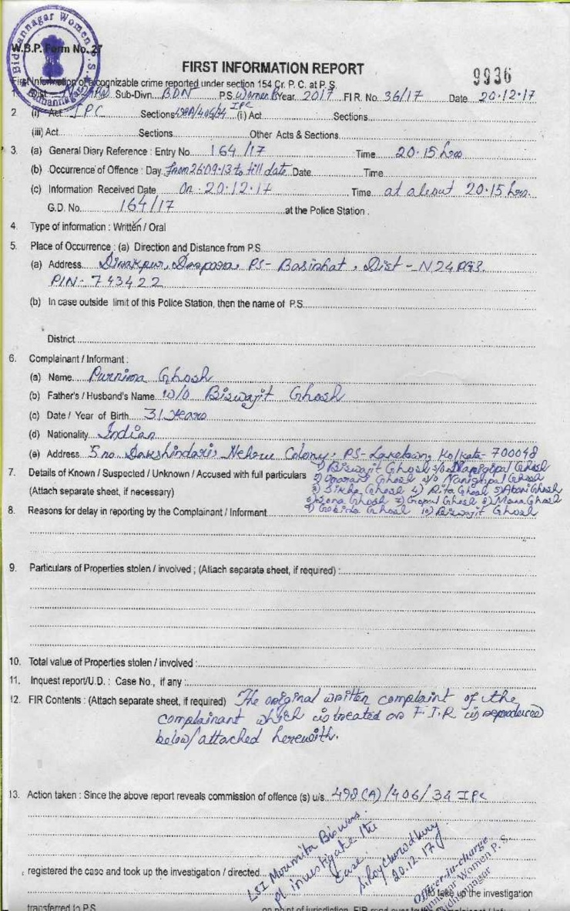
DATASET SAMPLE IMAGES OF FIR

Slide 41
PYTHON LIBRARIES AND TECHNIQUES USED
NUMPY
MATPLOTLIB
OPENCV
PYTESSERACT (FOR OPTICAL CHARACTER RECOGNITION)

Slide 42

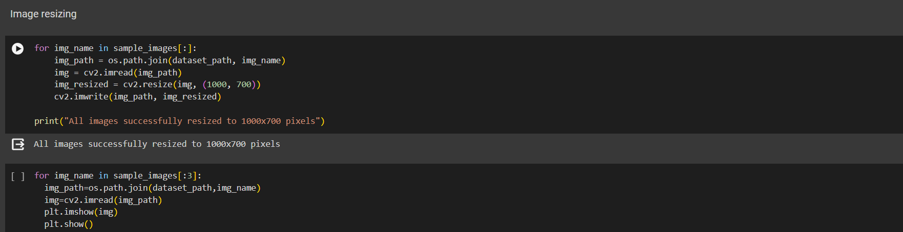
IMAGE PREPROCESSING
IMAGE RESIZING TO 1000 X 700 PIXELS

Slide 43
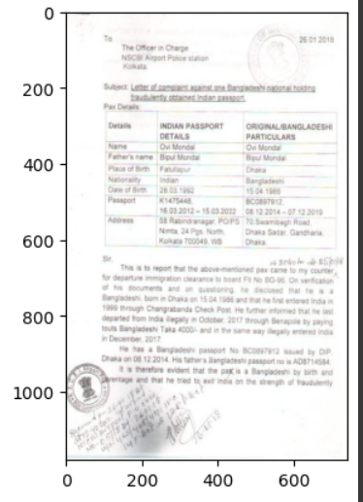
IMAGE PREPROCESSING
IMAGE RESIZED TO 1000 X 700 PIXELS

Slide 44
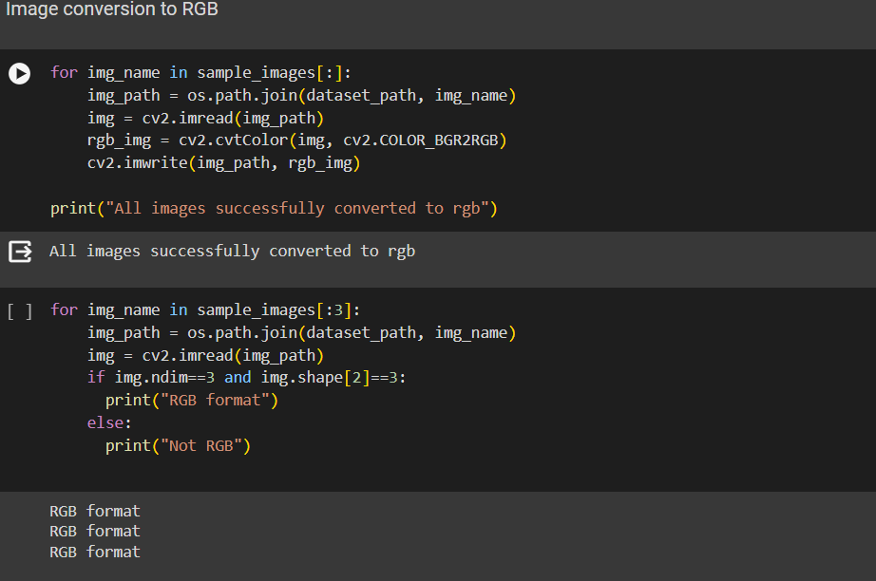
IMAGE PREPROCESSING
IMAGE CONVERSION TO RGB FORMAT.
Preprocessing of the image allows the better readability and ultimately helps in more accurate extraction of information.

Slide 45
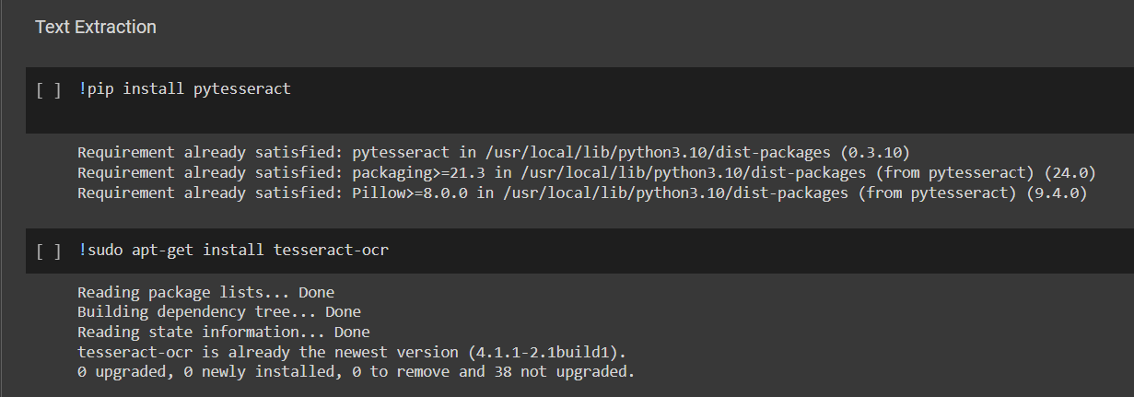
TEXT EXTRACTION USING PYTESSERACT

Slide 46
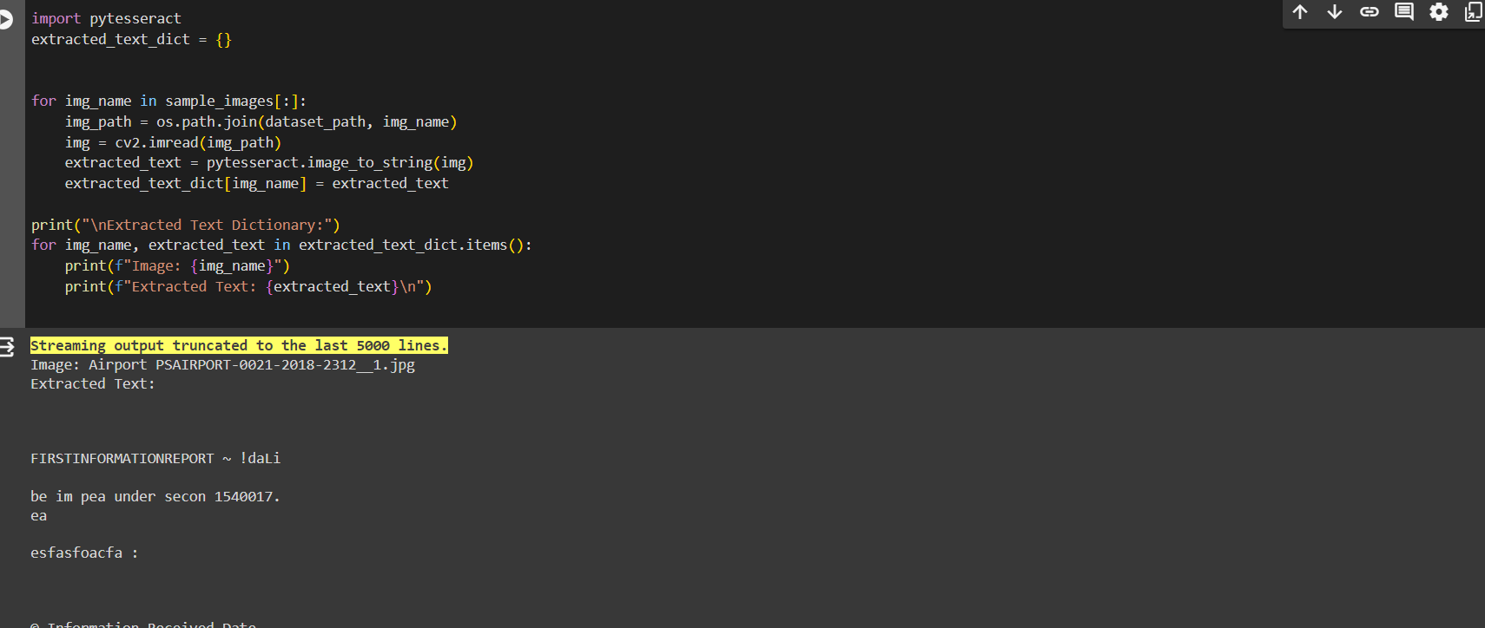
TEXT EXTRACTION USING PYTESSERACT

Slide 47
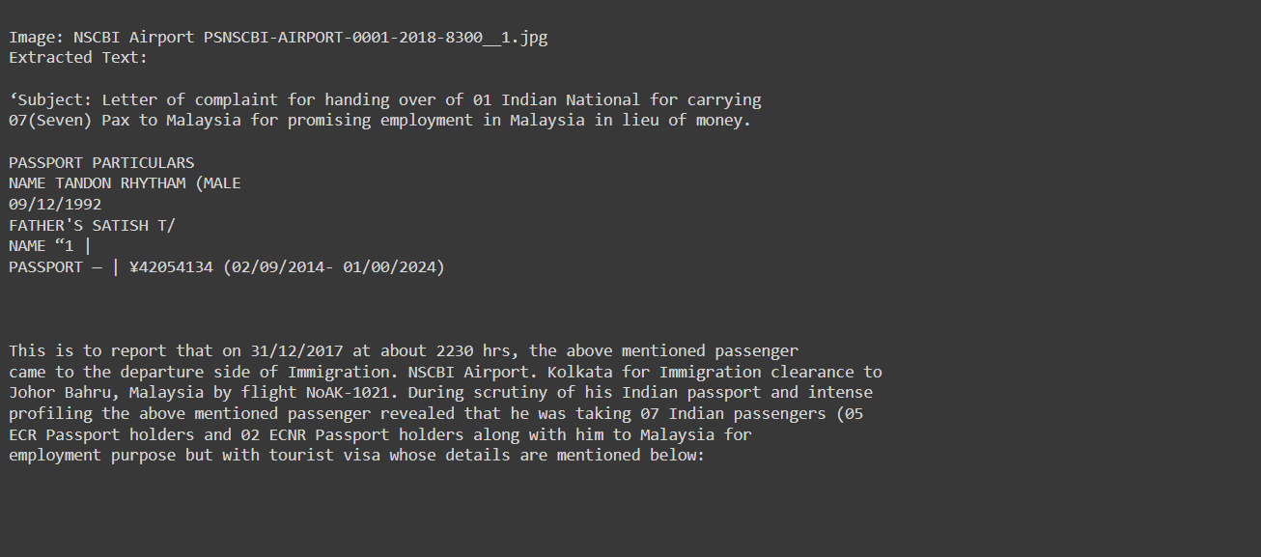
TEXT EXTRACTION RESULT

Slide 48
IPC SECTION DATASET SAMPLE
ipc_dataset= {
'2': ['punishment', 'offenses', 'committed', 'within', 'india'],
'3': ['punishment', 'offenses', 'committed', 'beyond', 'law', 'tried', 'within', 'india'],
'4': ['extension', 'code', 'extra-territorial', 'offenses'],
'8': ['gender'],
'11': ['person'],
'19': ['judge'],
'20': ['court', 'justice'],
'21': ['public servant'],
'22': ['movable property'],
'23': ['wrongful gain'],
'24': ['wrongful loss'],
'25': ['gaining wrongfully', 'losing wrongfully'],
'26': ['dishonestly', 'fraudulently', 'reason to believe'],
'34': ['acts', 'several persons', 'common intention'],
'35': ['act', 'criminal', 'criminal knowledge', 'intention'],
'36': ['effect caused', 'partly', 'omission'],
'37': ['cooperation', 'constituting', 'offense'],
'38': ['persons concerned', 'guilty', 'different offenses'],
}

Slide 49
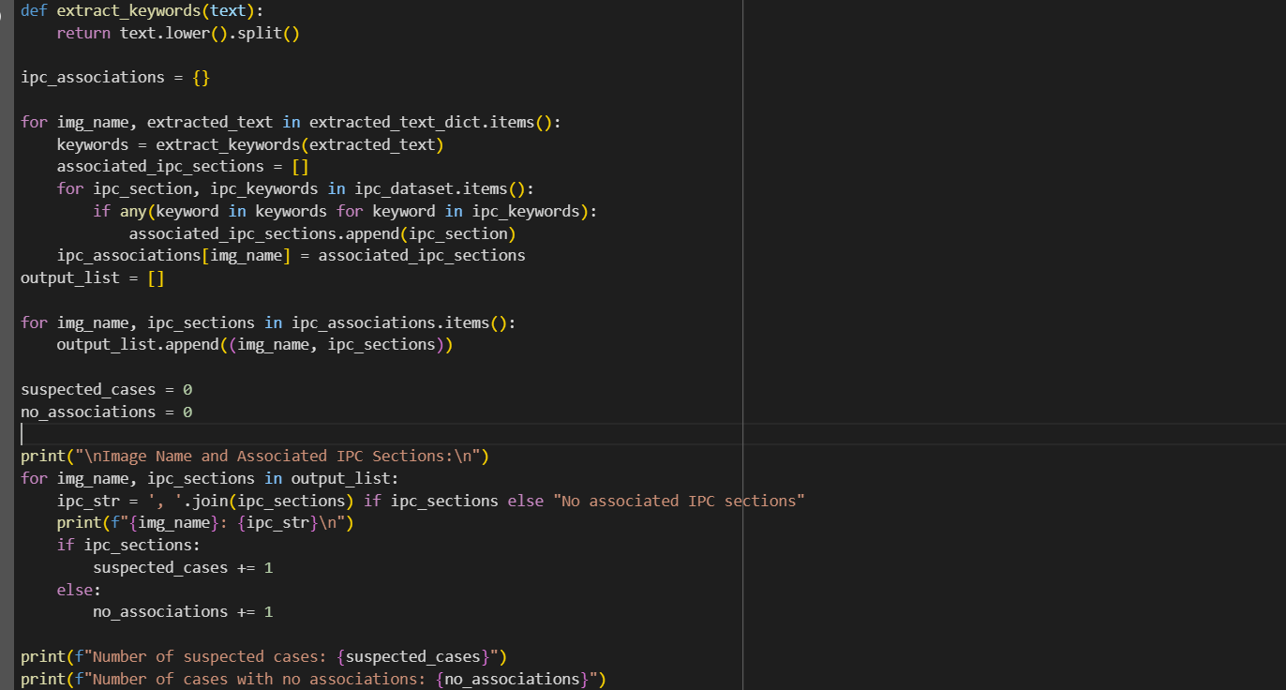
IPC SPECIFICATION FROM TEXT

Slide 50
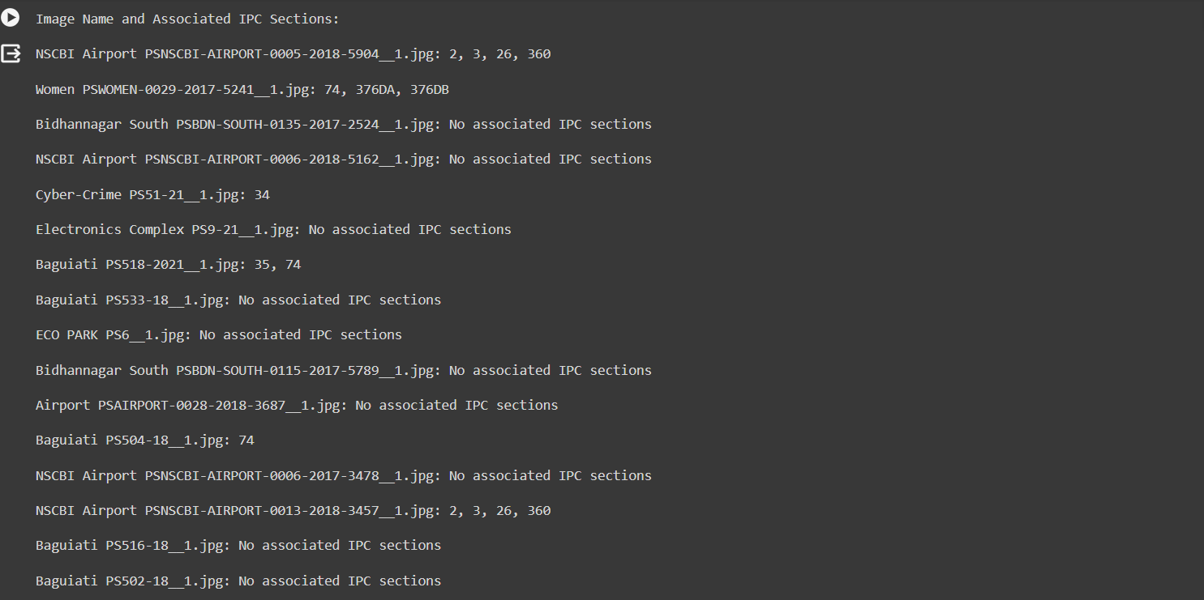
IPC SPECIFICATION RESULT

Slide 51
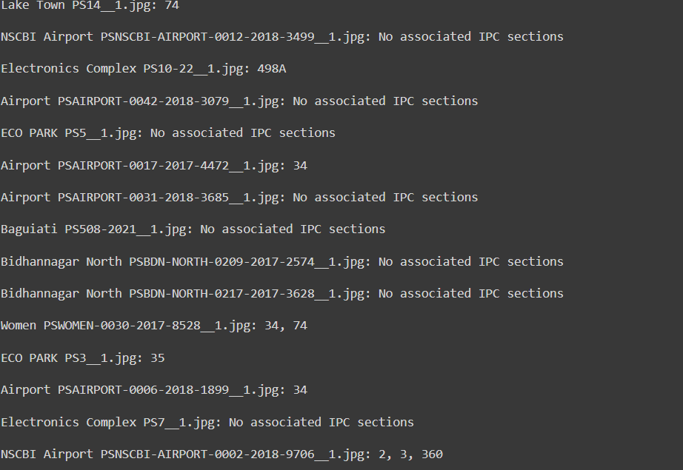
IPC SPECIFICATION RESULT
As we can see in the above results that some FIR does not conclude to any IPC section but some like the FIR of Women PSWOMEN-0030-2017-8528_1.jpg: concludes with IPC section 34 and 74

Slide 52
CONCLUSIVE ANALYSIS
The employed algorithm converts the extracted text using OCR technique to a vector of keywords. The keywords are then mapped to the IPC Section dataset whose example instance was shown previously.
Our Algorithm has an accuracy of 45% where it is able to extract information from the given image of the FIR and classify that FIR to a particular Indian Penal Code(IPC) section.
This reduces the manual t and tedious ask of classifying the FIR to a particular IPC section.

Slide 53
THANK YOU

